Slide 1

SDG 5 Gender Equality
Group 4
Silvia Shen | University of Amsterdam | 13582569
Megi Natchkebia | Georg-August University of Göttingen | 22350357
Tomás Meirelles | Universidad Del Desarrollo | 202111100C003
Femicide in China, Chile and Georgia

Slide 2


What is Femicide?
Defined as an intentional killing with a gender-related motivation (UN Women, 2023), femicide, killing women and girls because of their gender, is a growing issue globally and significantly impacts the lives of women and girls worldwide (Apakidze, 2024).
Femicide may be driven by stereotyped gender roles, discrimination towards women and girls, unequal power relations between women and men, or harmful social norms (UN Women, 2023). The Convention on Preventing and Combating Violence Against Women and Domestic Violence states that violence against women is a manifestation of historically unequal power relations between the sexes.

Slide 3
Data Collection
Identifying Femicide: Killing of women and girls because of their gender, which can take the form of, inter alia:
the murder of women as a result of intimate partner violence;
the torture and misogynist slaying of women
killing of women and girls in the name of “honour”;
targeted killing of women and girls in the context of armed conflict;
dowry-related killings of women;
killing of women and girls because of their sexual orientation and gender identity;
the killing of aboriginal and indigenous women and girls because of their gender;
female infanticide and gender-based sex selection foeticide;
genital mutilation related deaths;
accusations of witchcraft; and
other femicides connected with gangs, organized crime, drug dealers, human trafficking and the proliferation of small arms.
– European Institute of Gender Equality (2024)
Document analysis
Case studies
Desk research
Interview

Slide 4

Local Contexts
Chile
-480 women have been killed from 2014 to 2024
-There have been 1626 attempted femicides from 2014 to 2024
-Femicide was only partially codified into a law as recent as 2010, which shows an insufficient and tardy effort to eradicate not only femicide but gender violence
-In 2022, femicide-suicide was codified
China
- Over half of femicide suspects are intimate partner and/or family member
- From 2016 to end of 2023, the public security bureau in a western province have received an average of 2,400-3,600 cases of domestic violence each year that include severe violence such as homicide.
-The Anti-Domestic Violence Law of the People's Republic of China was first adopted as recent as 2015.
-Despite how death penalty may apply to homicide, most femicide criminals are sentenced to prison under 5 years.
Georgia
- Traditional understandings of gender roles are deeply rooted and widespread among the Georgian population
- 186 women have been killed in the timeframe of 2014-2022 (domestic violence or other motives)
- Failure of the court to prevent femicide - the issue of incorrect legal classification of the action

Slide 5
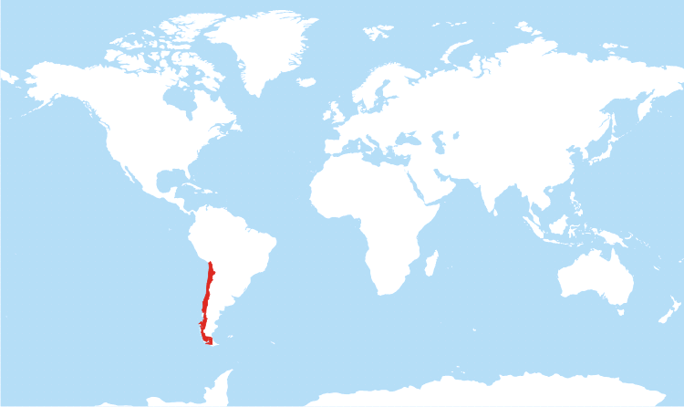


Suicide-femicide in Chile
Antonia Barra, aged 20, was raped by Martín Pradenas in 2019. Antonia was ashamed of what had happened to her yet she didn’t know who to talk to. A month later, she decided to talk to her ex-boyfriend which only made matters worse, he berated and insulted Antonia. The following day she reached out again to him, but this time saying her final goodbye. That same day, she committed suicide.
After countless protests demanding justice for Antonia, and 3 years later, Pradenas was sentenced to 20 years in prison.
The same year, a law that criminalizes femicide suicide was passed, the Antonia Law.

Slide 6
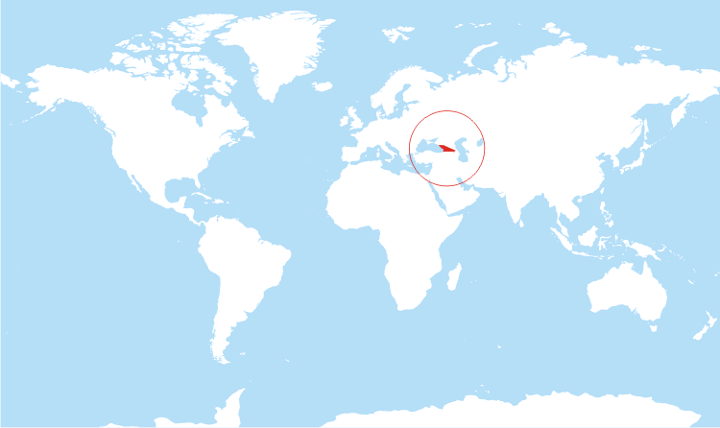

The case of femicide in Georgia
In 2020, In a small city of Georgia, a husband was arrested on the charge of killing his wife.
According to the investigation, the man allegedly killed his sleeping wife late at night with a hunting rifle.
The woman died on the spot from the fatal wound.
Three minors were in the house at the time of the murder.
According to neighbors, after committing the crime, the murderer woke up his children and told them that he had killed their mother.
Relatives of the deceased woman say that he was addicted to alcohol and was aggressive recently.
Also, according to reports, the man had problems with the law enforcement officers.

Slide 7
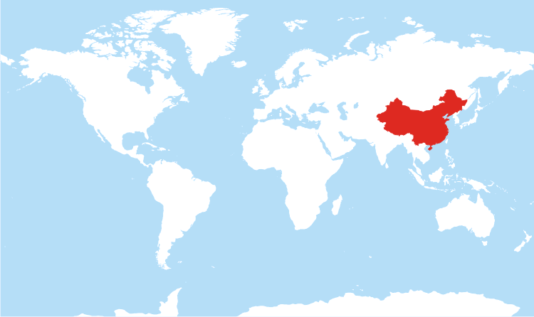
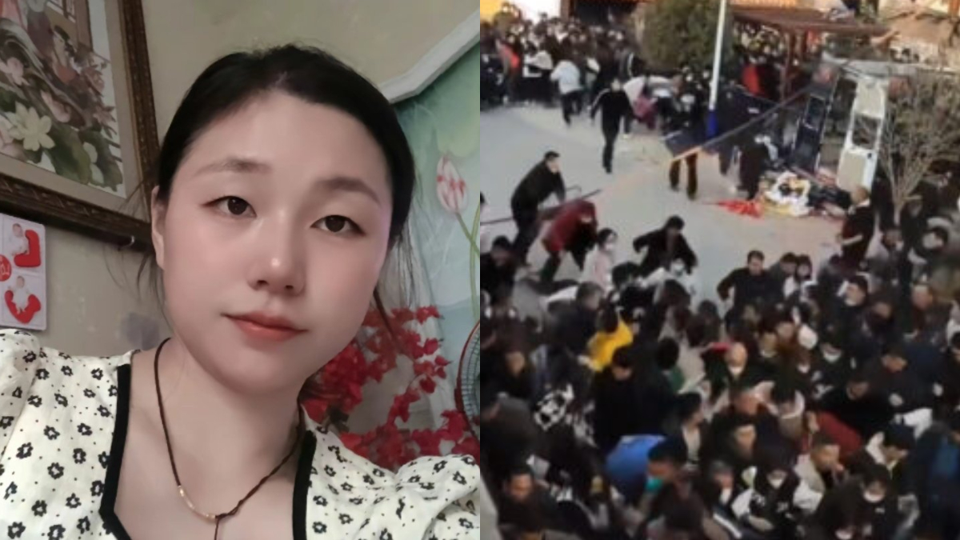
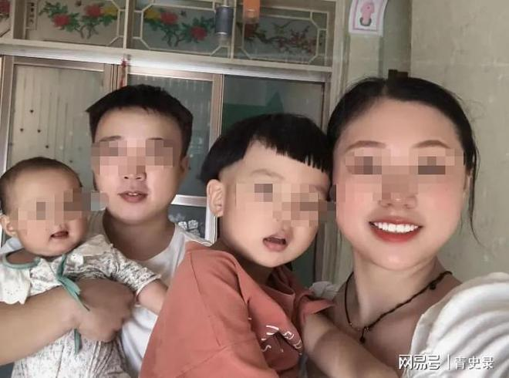
Femicide in China: a tragedy under patriarchy
On February 20, 2023, a man named Zhang Hao killed his wife, Yang Fang, by hacking her 8 times with a knife. They have one son and one daughter together. Yang was feeding their one-year-old baby when this happened.
A month before the tragedy, Yang has informed Zhang about her decision on getting a divorce. Zhang’s mother told Zhang “don’t be scared, even if you killed her, we can bail you out with money and get you another wife”.
Zhang’s family left Yang’s body in their old house for 5 days without informing Yang’s family. On the 7th day, police took her body away from her parents by force. Official report claimed government gave her cremation and has returned her ashes to her parents. Locals showed anger and had conflicts with police, questioning the police by corruption and improper law enforcement.
On the 8th day, Zhang’s mother appeared on social media. She claimed angrily that it’s “all Yang’s fault not knowing how to run”, and that Zhang “now has to court all because of her”. Until today, this case is still awaiting trial.

Slide 8
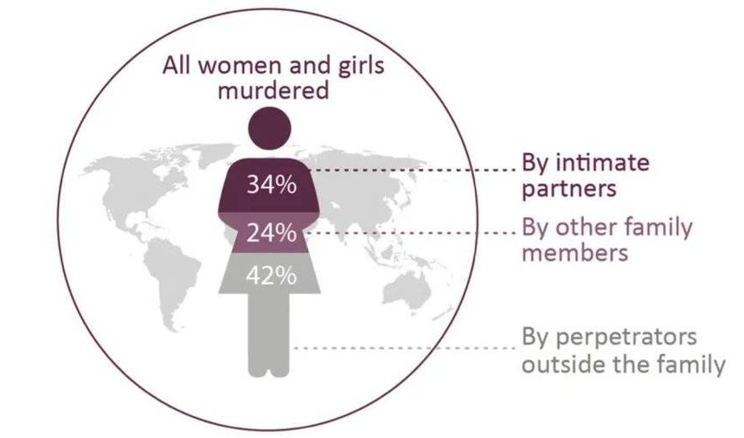
Problem & Root
Problems:
In all 3 countries presented, femicide cases mostly happen at home and is also a case of domestic violence committed by a male husband/ex-husband/partner.
Legal problems of defining femicide and issuing a penalty
Femicide motivations, mainly jealousy, are shared among all 3 countries.
Roots of the problems:
Patriarchal culture
Insufficient media representation: silent goats
Lack of legal attention
Insufficient social support, especially in the case of partner/family-related homicide

Slide 9
Local Solutions
Chile
Discourage possible femicides by strengthening the legal framework with stricter penalties for perpetrators.
Raise awareness, every women could be a victim, Chile has to make sure that the tabooism is rooted out of chilean society.
Spread the word, even if already there are resources and available for women, a majority of them doesn’t know where to find them.
China
Ensure efficient cultural production (news, social media) on the topic of femicide to raise public awareness.
Clarify femicide in criminal laws and ensure strict and just legal punishments.
Embed gender equality and human right values in compulsory education
Ensure in-time intervention on violence, from police, All-China Women's Federation, and neighborhood council.
Georgia
Constant awareness raising from an early age both to boys and girls about general human rights, women rights and citizenship rights. (within schools or informal education)
Ensuring a better support system for women facing domestic violence (accessible information about shelters, contact persons, contact entities)
the country should take effective steps to increase women’ economic participation, promote equal economic opportunities for women and men, advance gender balance in decision making.
Courts should refuse to use a conditional sentence in the event of a recurrence of a crime, in order to achieve one of the functions of punishment - crime prevention.

Slide 10
Global Solution
Even though there’s no such thing as a unique global solution that would end gender violence, there are things that apply to most countries and more specifically each of the 3 countries we presented previously. These are some of our propositions to contribute in solving the matter that can be applied mostly everywhere and will have similar effects only with different degrees of impact.
The solutions
Start from the roots of patriarchal culture, raising awareness on human rights and gender equality at schools from an early age, adequate material suited to the age
Encourage cultural production on Femicide (e.g. movies, exhibitions, songs, news reports, etc)
Propagate the notion of femicide on social media, encourage gender-equality-related content
Making “getting help” more accessible
Create an effective legal framework
Invest in women’s economic empowerment

Slide 11
Solution Justifications & Improvements
Desirability
As demonstrated in slides 4-7, all three countries face the problem with femicide. Issues mainly distribute in patriarchal social norms, lack of efficient intervention and the void of femicide in legal systems. Solutions are therefore developed based on these shared needs.
China: Gender equality awareness and culture are the most significant in preventing femicide in China. Cultural interventions such as education and media production (movies, social media content, etc.) liberate women’s thoughts, thereby awakening their consciousness of resistance and awareness of self-protection. Meanwhile, the interviewee was negative in the feasibility of providing more in-time support for victims. Organizations such as All-China Women’s Confederation do not have the funds nor legal rights on crime interventions. It is believed that the efficient solution is raising female rights’ awareness, through which people are encouraged to protect themselves and help others in need.
Chile: In Chile there’s an noticeable lack of education and awareness on the subject,in fact, there’s a high chance that everyone knows at least of one victim of gender violence, however we don’t always know who that is because many times the victims feel humiliated of having been victim of such a thing so they don’t seek out help, so even if Chile has the “stronger” legal framework out of the three presented countries, it’s been proved time and time again that the fight against femicide has to be proactive instead of reactive, meaning that there’s still a cultural and mentality change that needs to happen in order to reduce and eventually end femicide and this change can be achieved through early education in schools and in every home.
Georgia: To effectively reduce femicide in Georgia, prevention, investigation, and appropriate punishment are essential tools. Prevention involves adopting laws that recognize gender-based motives for murder as aggravating circumstances. For example, Georgia implemented such an amendment in 2019, so femicide is no longer treated as a simple murder. This is crucial because femicide often results from long-term abuse that the police knew or should have known about. Punishment should include timely investigations into the gender motive behind the crime and avoid secondary victimization (e.g., blaming the victim because she had a lover). Perpetrators should receive appropriate punishments and be required to undergo mandatory rehabilitation programs in prison, which currently do not exist in Georgia. Additionally, vulnerable groups are at a higher risk of becoming victims of femicide. Therefore, tailored prevention and protection mechanisms for these groups are key to addressing this issue effectively.
Feasibility
Cultural productions (movies, shows, social media content): Financially beneficial from theater/platform profits
Women economic empowerment: Increased labor in the society
Education: few additional cost compared to lower femicide rate in a long-term
Viability
Notes:
Interviewees:
China: vice chair of All-China Women’s Confederation: People’s Third Hospital of Mianyang
Chile:
Georgia: Anna Iluridze - Expert in Gender and Social Inclusion at GIZ |Gender and Development worker with legal background

Slide 12
References
A/CONF.157/23. UN General Assembly (1993, July 12). Vienna Declaration and Programme of Action. The World Conference on Human Rights. May 14, 2024. https://www.refworld.org/legal/resolution/unga/1993/en/14730
Apakidze, N. (2024). Recent statistics related to violence against women, and legislative changes in Georgia. Tracking Violent Crimes against Women. May 2024, http://www.femicide.ge/eng/list/show/287-Recent-statistics-related-to-violence-against-women-and-legislative-changes-in-Georgia
Bouzerdan, C., & Whitten-Woodring, J. (2018). Killings in context: An analysis of the news framing of femicide. Human Rights Review, 19, 211-228.
Cayli Messina, B. (2022). Breaking the silence on femicide: How women challenge epistemic injustice and male violence. The British Journal of Sociology, 73(4), 859-884.
Dayan, H. (2022). Crime Diversity: Sociocultural Aspects of Femicide in Hong Kong. Journal of interpersonal violence, 37(15-16), NP14431-NP14456.
European Institute for Gender Equality. (2016). femicide. femicide | European Institute for Gender Equality. May 14, 2024, https://eige.europa.eu/publications-resources/thesaurus/terms/1192?language_content_entity=en
Fenley, L. (2014). Femicide Rooted in Patriarchal Culture.
Formula news (2020) The worst case of femicide in Suram - a husband allegedly killed his sleeping wife with a hunting rifle.
Public Defender of Georgia. (2022, July 6). Femicide Monitoring Report 2020. Retrieved from https://ombudsman.ge/eng/201117012751angarishebi/femitsidis-monitoringis-angarishi-2020 Yang, Y. (2020, November 26). 中国恶性家暴事件引关注 女性权利组织呼吁全社会共同应对. VOA China. https://www.voachinese.com/a/China-domestic-violence-an-imminent-issue-that-needs-to-be-addressed-20201125/5676197.html
過去一年，發生在中國大陸的「性別謀殺」｜端傳媒 Initium Media. 简端. (2023). https://campaign.theinitium.com/20220506-mainland-covid-shanghai-lockdown/index.html
女子:离婚，婆婆:以下犯上该死，随即丈夫8刀发生了滑县杀妻案. 网易首页. (2023, October 20). https://www.163.com/dy/article/IHH7IRQ10552JTZ1.htm.
National Service of Women and Gender Equity. (2024). Femicidios 2024: Actualizado 23-04. https://www.sernameg.gob.cl/wp-content/uploads/2024/04/FEMICIDIOS-2024_actualizado-23-04.pdf
BBC Mundo. (n.d.). Chile: La lucha contra los feminicidios. BBC. https://www.bbc.com/mundo/articles/cw81l4xggezo
Ministerio de la Mujer y la Equidad de Género. (n.d.). Gobierno presenta plan integral para prevenir femicidios. https://minmujeryeg.gob.cl/?p=49480

